Slide 1

Module 0
Matrix / Tensor Algebra
Notes:
Guidelines
Use section headers to chunk content in your presentation.
Use the same style of section header throughout your presentation.
Keep your title to no more than 2 lines.

Slide 2
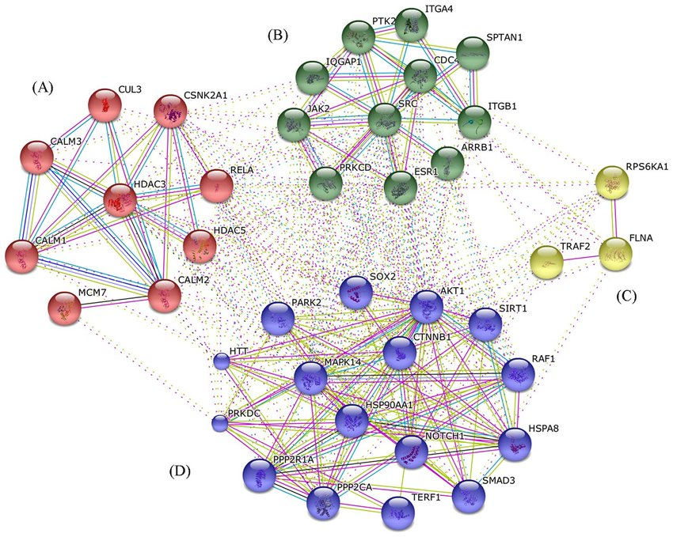
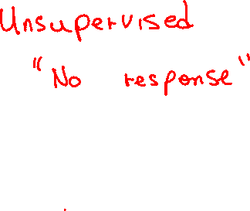
Cluster Analysis
Notes:
Guidelines
Use a title slide at the beginning of your presentation. There are 9 variations of title slides to choose from.
If you will have a series of slideshows, we recommend using the same style of title slide for each presentation.
Keep your title to no more than 2 lines.
Do not change the font style or font size of the title or subtitle.

Slide 3
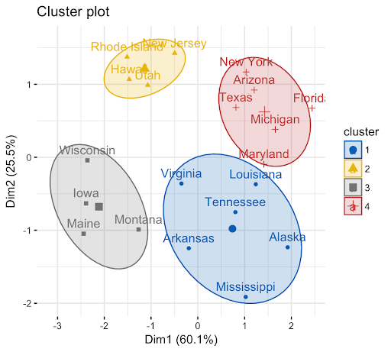
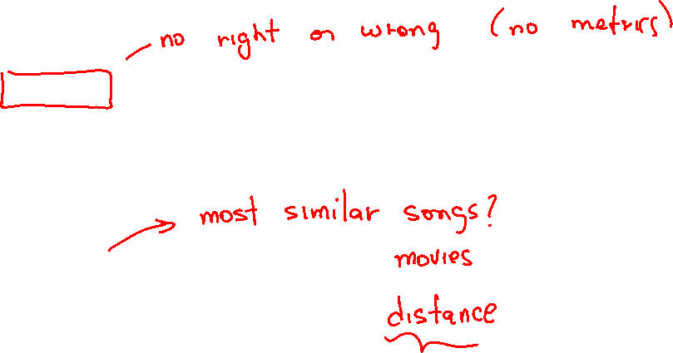
Cluster Analysis
Goal: to segment the data into a set of homogenous groups (clusters) of observations

Slide 4
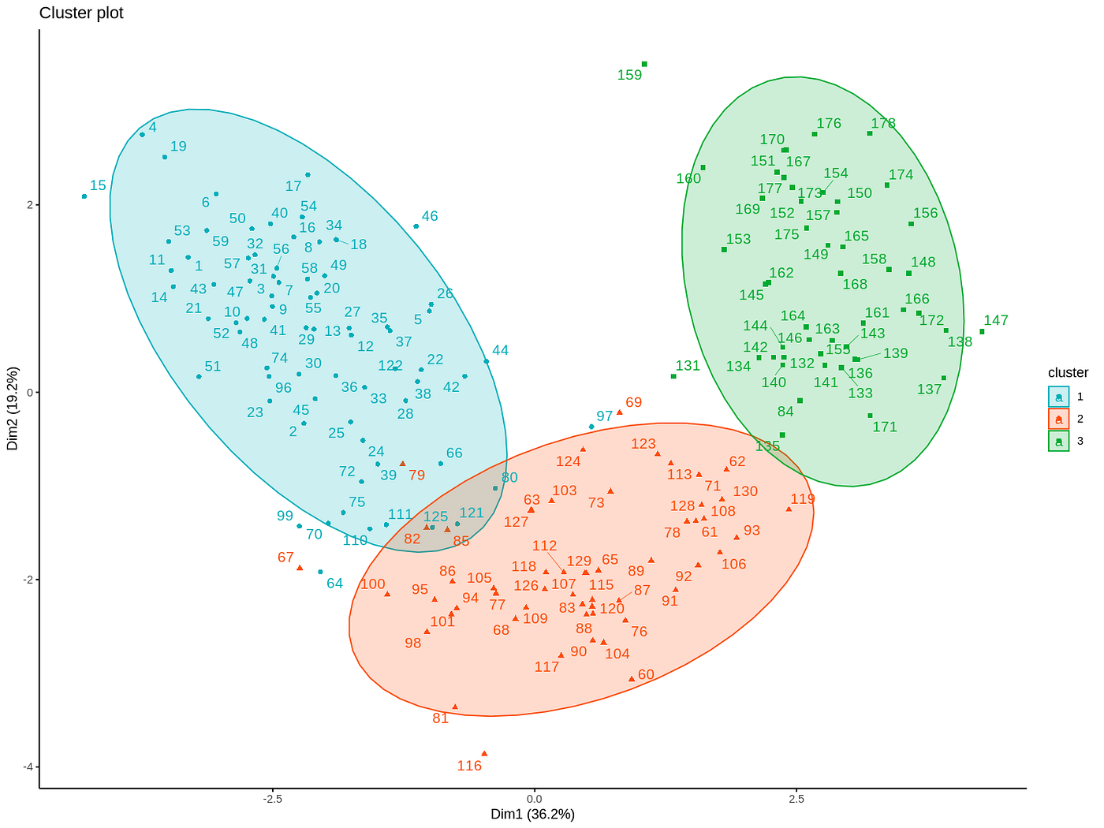
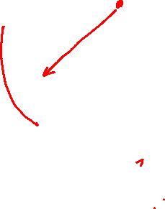
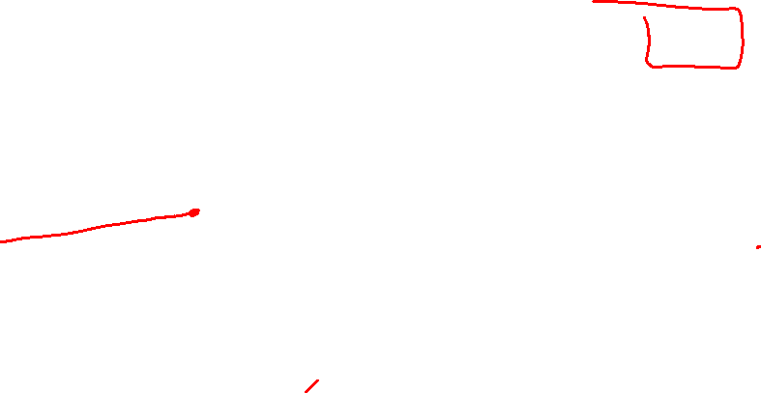
Measures of Distance
We use distances to find out if observations are “alike”.
We need to determine if observations with small distances to each other belong in the same group.

Slide 5


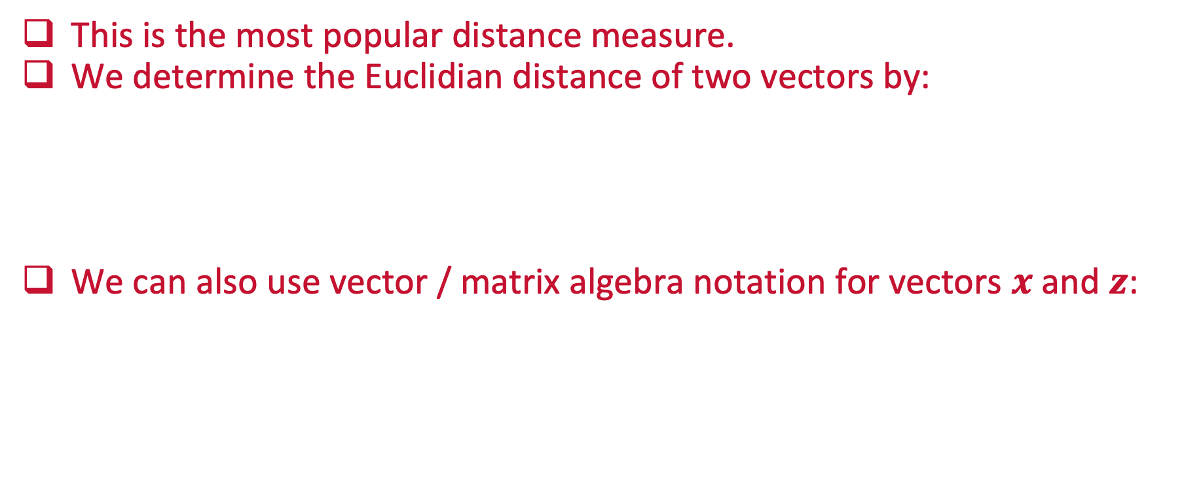
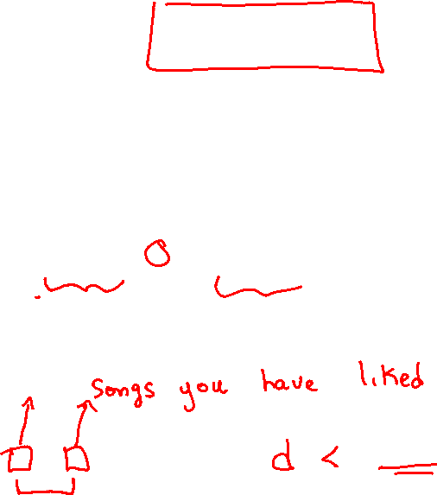
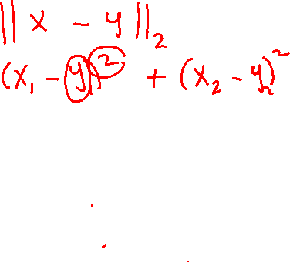
Euclidian Distance
This is the most popular distance measure.
We determine the Euclidian distance of two vectors by:
We can also use vector / matrix algebra notation for vectors $x$ and $z$:

Slide 6
Python
Notes:
Guidelines
Use a title slide at the beginning of your presentation. There are 9 variations of title slides to choose from.
If you will have a series of slideshows, we recommend using the same style of title slide for each presentation.
Keep your title to no more than 2 lines.
Do not change the font style or font size of the title or subtitle.

Slide 7
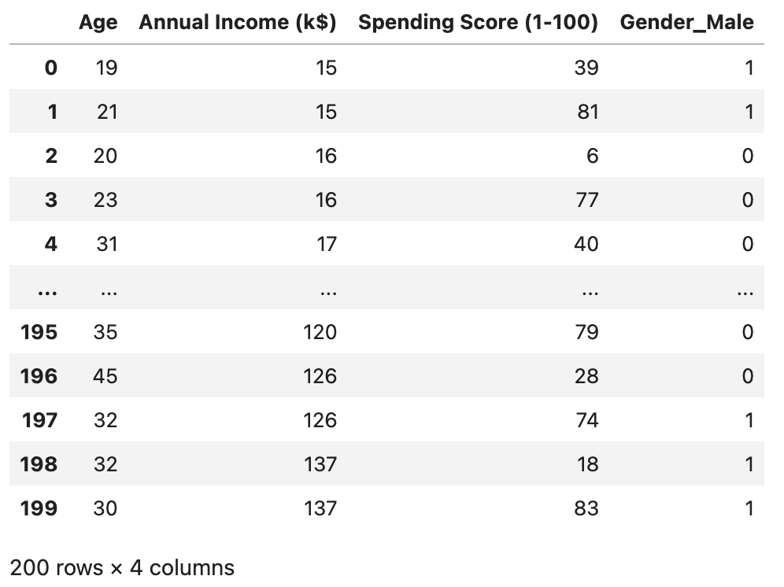
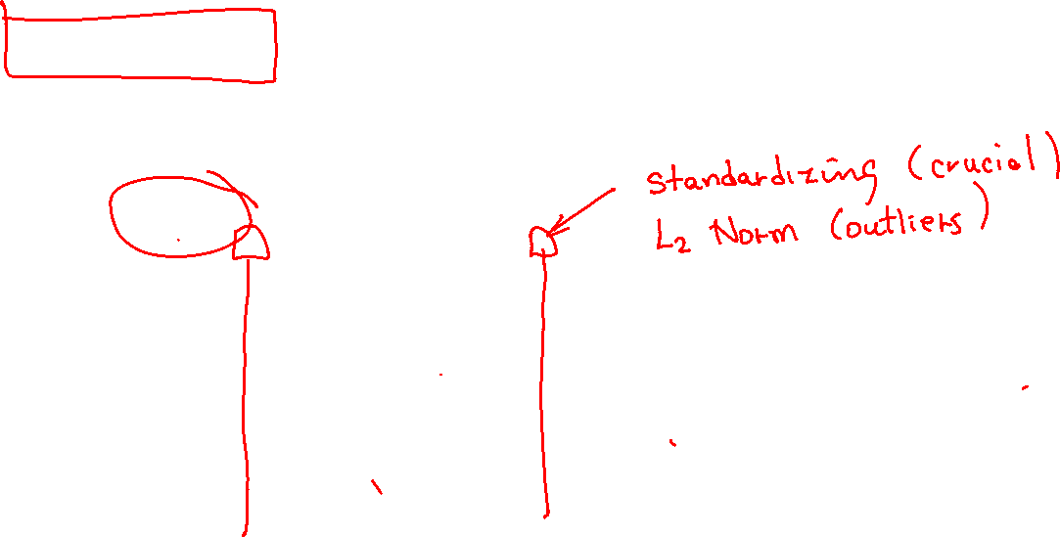
Euclidian Distance Example
Clustering Customers

Slide 8
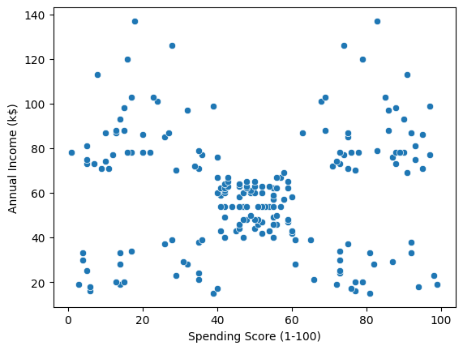
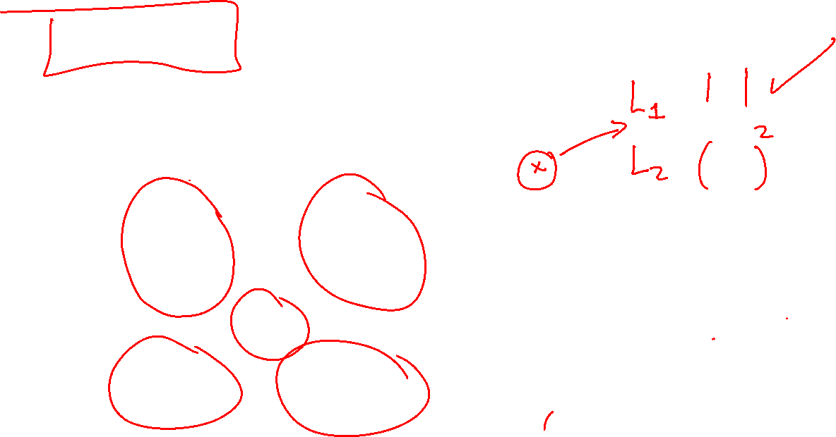
Euclidian Distance Example
Clustering Customers

Slide 9
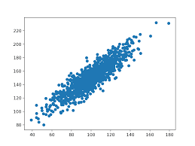

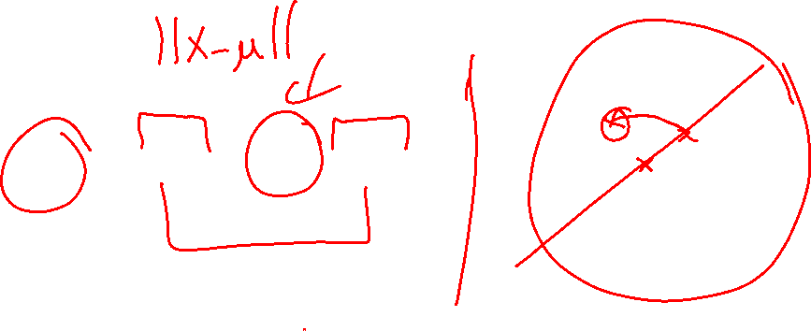
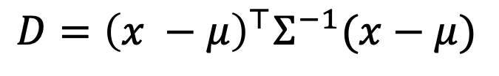
Drawbacks of Euclidian Distance
You must scale your data
It completely ignores relationships between variables
If you have outliers you might consider the Manhattan distance.
For example, the statistical distance considers the covariance matrix $Σ$:
$$D={\left(x −μ\right)}^{⊤}Σ^{−1}(x−μ)$$

Slide 10
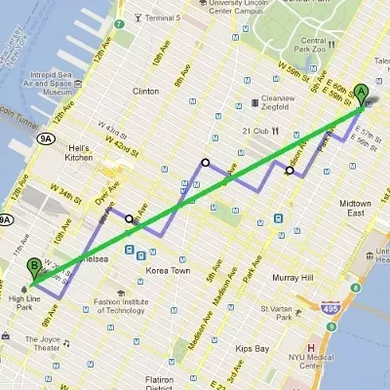
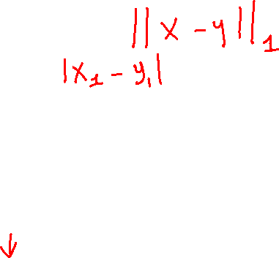
Drawbacks of Euclidian Distance
You must scale your data
It completely ignores relationships between variables
If you have outliers you might consider the Manhattan distance.
For example, the Manhattan distance uses absolute values:
$$D={\left|\left|x −z\right|\right|}_{M}=\left|x_{1}−z_{1}\right|+\left|x_{2}−z_{2}\right|+ …+|x_{p}−z_{p}|$$

Slide 11
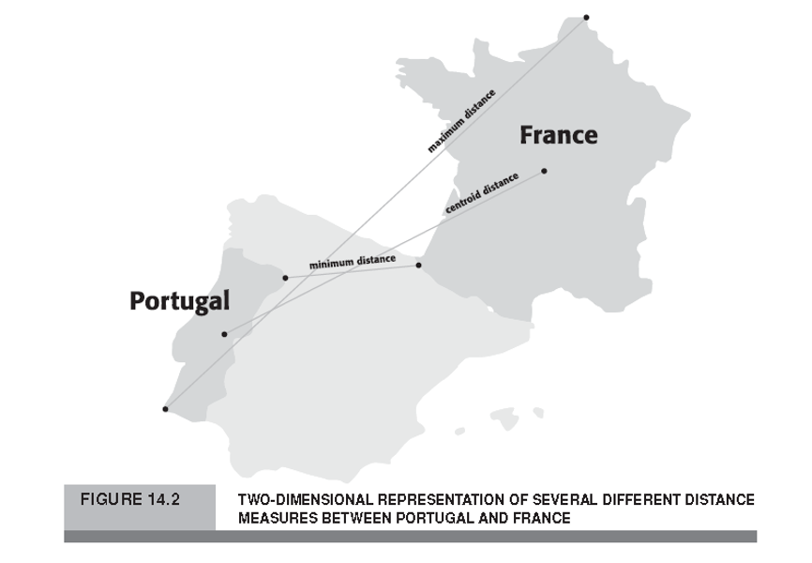
How do we Distance Between Clusters?
Minimum Distance
Maximum Distance
Average Distance
Centroid Distance

Slide 12
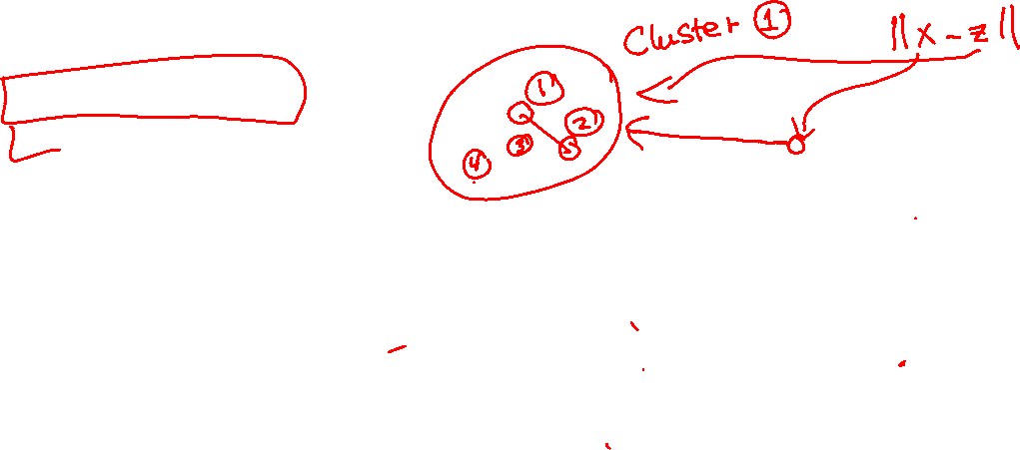
How do we Distance Between Clusters?
Minimum Distance
Maximum Distance
Average Distance
Centroid Distance

Slide 13
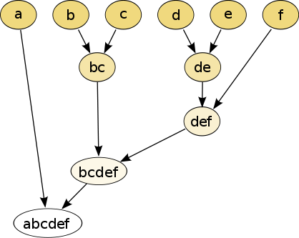

Types of Clustering Techniques
Hierarchical Methods
Non-Hierarchical Methods

Slide 14
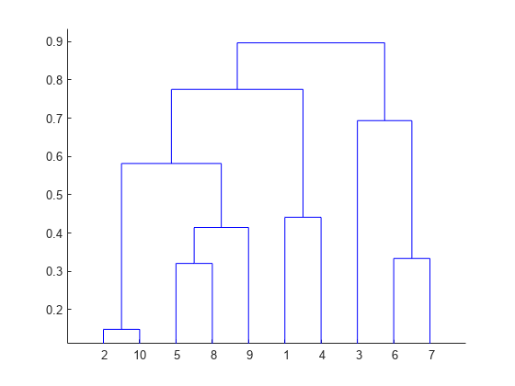
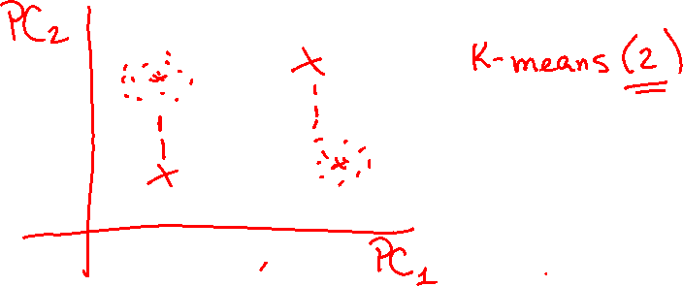
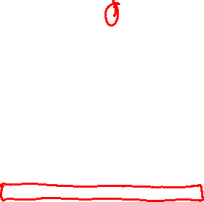
Hierarchical Methods
Starts with each cluster comprising a small or one number of observation.
Progressively combine the two nearest clusters until there is just one cluster left at the end which consists of all observations.
Dendogram:

Slide 15
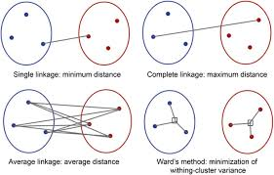
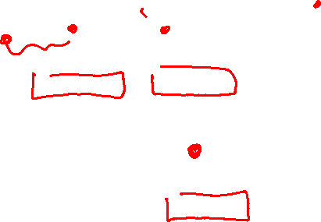
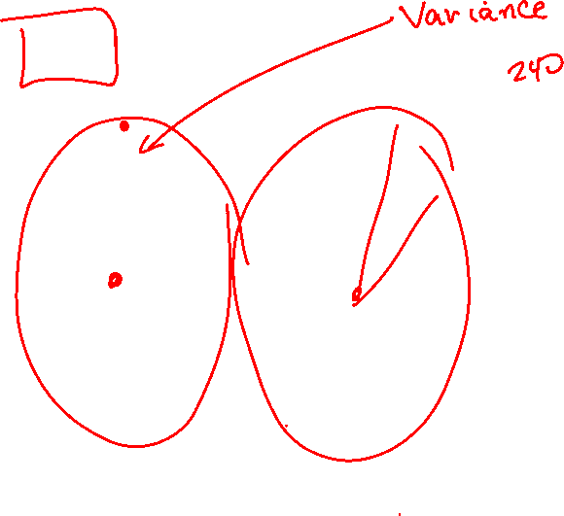
Hierarchical Methods
Ward’s Linkage Algorithm

Slide 16
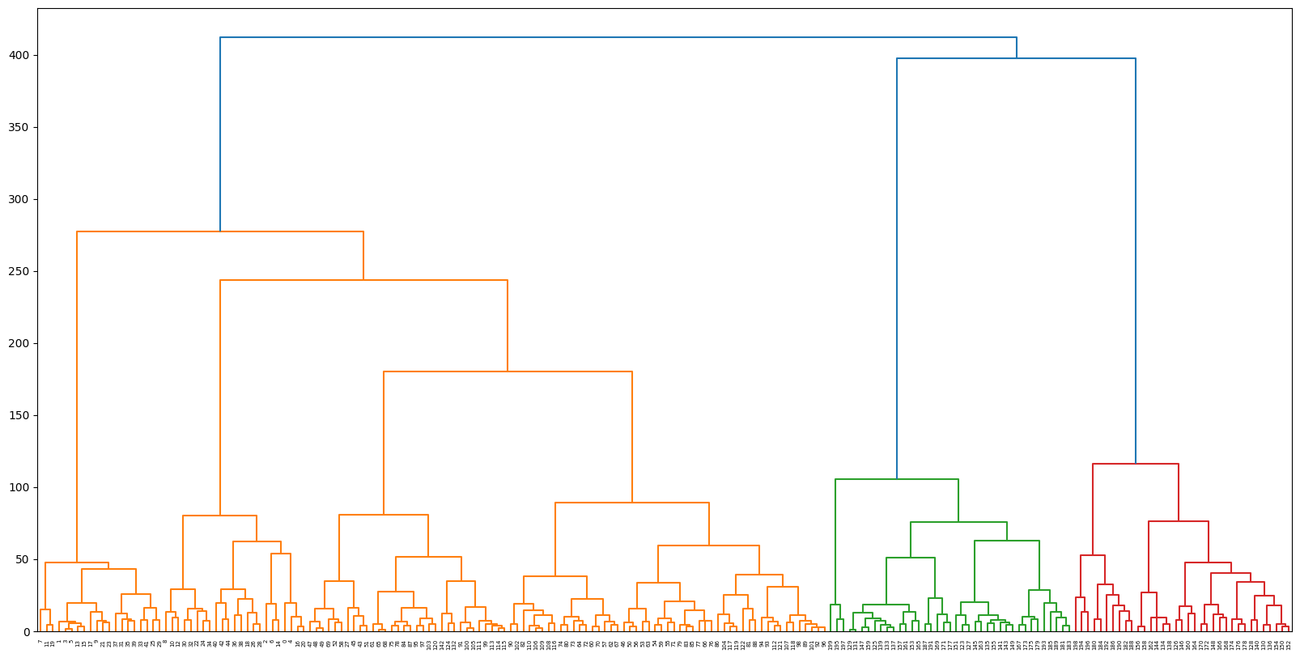
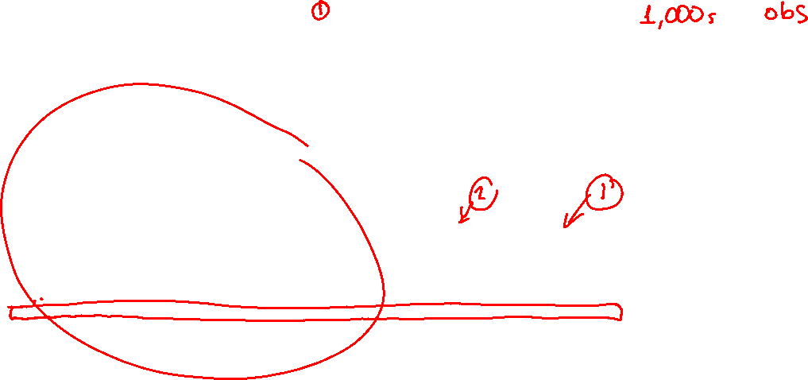
How to Find Number of Clusters
Dendogram:

Slide 17
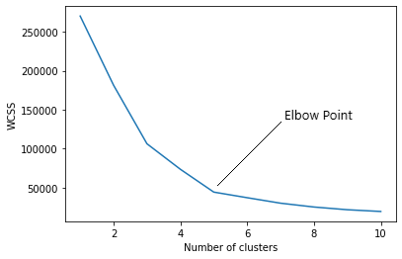
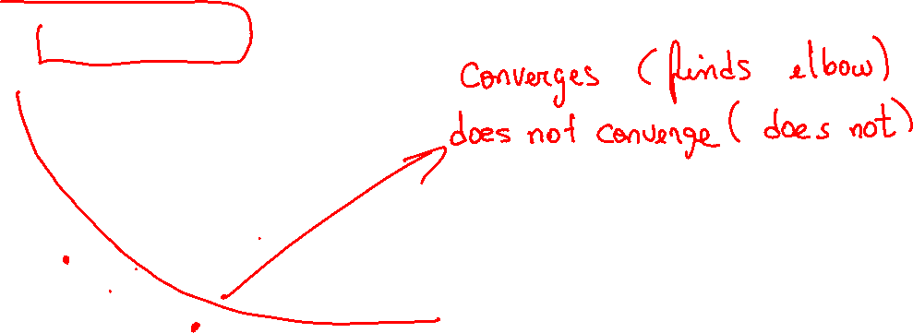
How to Find Number of Clusters
Elbow Method: we fit the clustering algorithm for various values of �, say 1 to 10 and determine where there is a leveling of the the within-cluster sum of squares (WCSS).

Slide 18
Python
Notes:
Guidelines
Use a title slide at the beginning of your presentation. There are 9 variations of title slides to choose from.
If you will have a series of slideshows, we recommend using the same style of title slide for each presentation.
Keep your title to no more than 2 lines.
Do not change the font style or font size of the title or subtitle.

Slide 19
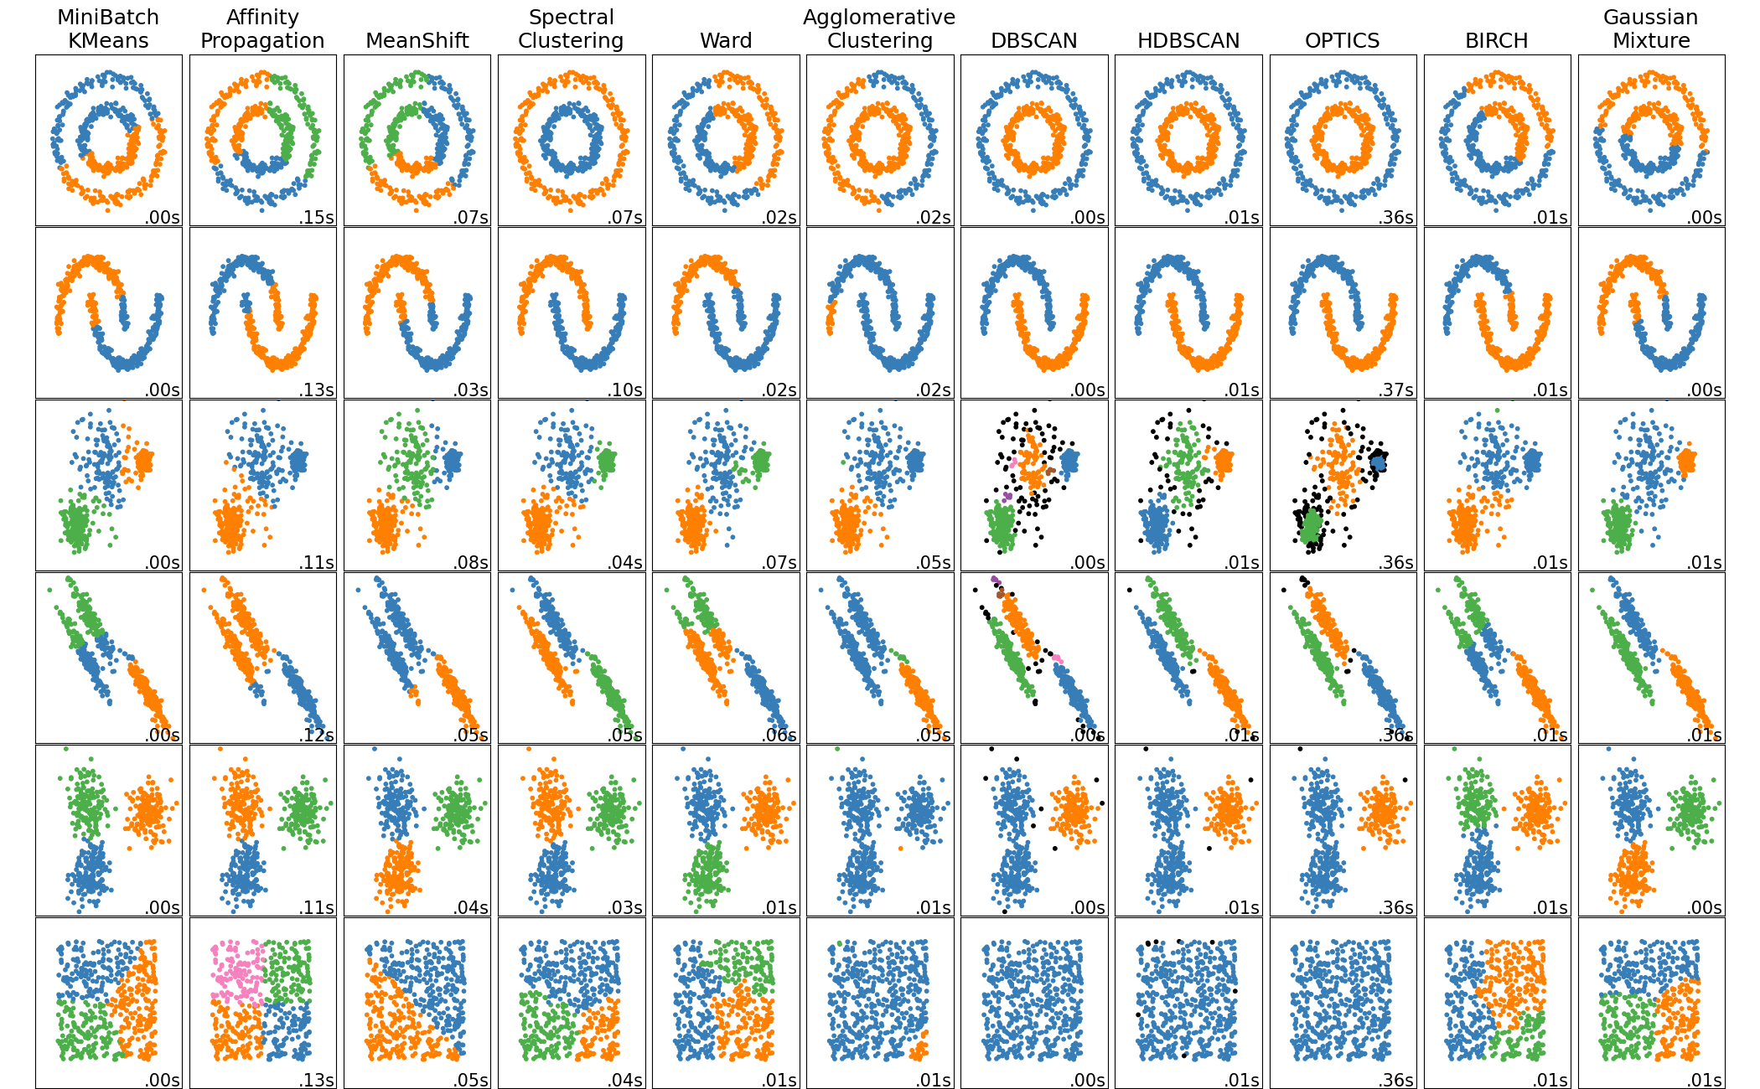
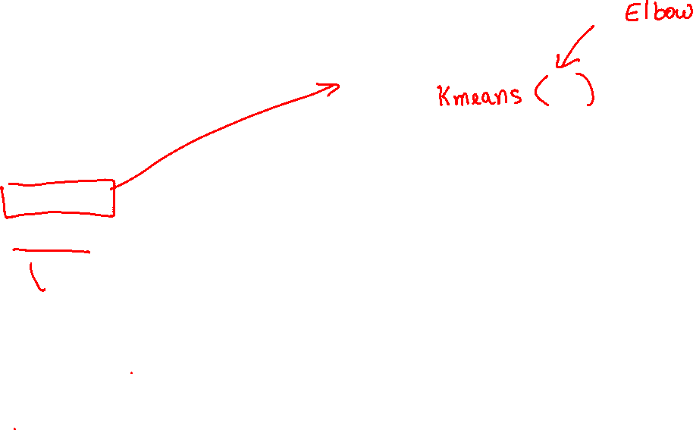
Non-Hierarchical Methods
Iteratively assign objects to different groups while searching for some optimal value of the criterion
K-means
DBSCAN

Slide 20
Python
Notes:
Guidelines
Use a title slide at the beginning of your presentation. There are 9 variations of title slides to choose from.
If you will have a series of slideshows, we recommend using the same style of title slide for each presentation.
Keep your title to no more than 2 lines.
Do not change the font style or font size of the title or subtitle.

